Slide 1

Virtual PTO Meeting
Tuesday, October 12
6:30pm
Join Via WebEx
Join WebEx meeting
Meeting number/Access Code: 2300 355 5524
Meeting password: KsdPe7Bpz62
Join by phone
+1-415-655-0002 US Toll
+1-904-900-2303 United States Toll (Jacksonville)

Slide 2
Agenda
OES PTO MEETING 2021
Welcome
Standing Agenda
Guest Speaker: Melaine Klages - Nurse
Foundation:
President’s Report: Michele Hildebrand
Treasurer’s Report: Janet Blanco
Principal’s Report: Ms. Abes
Teachers Report: Tiffany Brown & Cynthia Thompson
Open Discussion
Next PTO Meeting: Tuesday, October 12th
Adjournment

Slide 3
Standing Agenda
OES PTO MEETING 2021
2021-2022 PTO Officers
  Michele Hildebrand – President
  Jeannette Blaustein –Vice –President
  Janet Blanco – Treasurer
  Aimee Aubrey --Secretary
Communication
  Facebook- OES Families, please “Like” us
  Administration school Facebook page--Oasis Elementary South
  Parent Square and Panther Press
  PTO Rocks on the website

Slide 4
School Nurse
Guest Speaker:
Melanie Klages

Slide 5
Foundation
Lighthouse Award’s
The Lighthouse Award Recognition Program is administered by the Cape Coral Municipal Charter School Foundation and overseen by the Lighthouse Award Committee, comprised of members of the Municipal Charter School Foundation.
    EVENT COMMITTEE
    OBSERVATION COMMITTEE
    SELECTION COMMITTEE
To Volunteer please go to OES Families
.
WINNERS WILL BE ANNOUNCED AT THE LIGHTHOUSE AWARDS DINNER ON SUNDAY, MARCH 6, 2022

Slide 6
President’s Report
Past Events
  Boosterthon was very successful—Thank you!
  Restaurant Cards-- HUGE SUCCESS!
  Box Tops
  Staff/Teacher Appreciation has been busy
    Donuts
    Lemonade Bar
    Columbus Day
Upcoming Events
  Trunk or Treat
  Staff/Teacher Appreciation
  Frosty’ s Factory
  Veterans Day Bulletin Board
New Business
  Fall Festival
Old Business
  Committee’s

Slide 7
Boosterthon

Slide 8
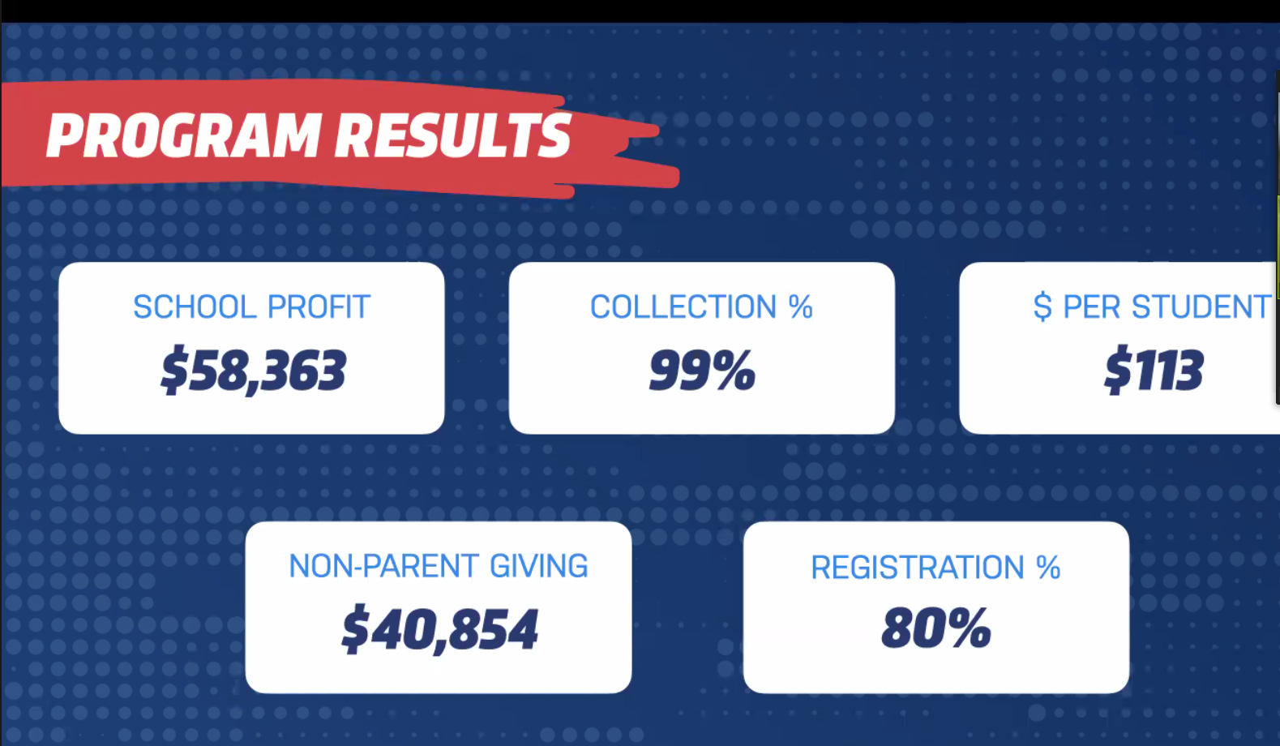
Boosterthon

Slide 9
Boosterthon
PTO Board and Administration are meeting to lay out a plan for how the funds will be spent.
                How much is still needed for technology?
                What do we need or want for our playgrounds?
                Appreciation – additional funds. (Additional discussion at treasure report)
Some additional fun for the kids!

Slide 10


Slide 11


Slide 12
Event: October 29th, 6-8pm (Spots are limited)
Cars:
Themes must be kid friendly
If other parents in classroom would like to help, please work together
    Create a wish list or sign up genius so parents can donate items
Start setting up no later then 5:00pm, needs completed at 5:45 pm for start of event
Car’s must stay till 8:00pm
Winners of the contest will win a gift card for classroom
Interested:
Reach out to your teacher
There is a sign up genius to be the lead for the car after the teacher approves.

Slide 13
Volunteers:
Still needing additional volunteers for this event
Help with Mrs. Gamboa’s pumpkin patch
Help with the car voting
Help with Car line up
Aimee Aubrey
Jeannette Blaustein
Mara Brown
Tiffany Zebley
Rebecca Kinsley
Lindsey Zimmerman

Slide 14


Candy, Candy, Candy
Two ways to donate Candy
Straight to the classroom—this will go directly to the class car
PTO –drop off at front office. We will go around to make sure everyone has enough candy or encourage sharing between cars
We have had over 1,000 kids in the past participate in this event!!!!!

Slide 15
More Info to Come

Slide 16
Fall Festival
Could become a Spring Festival

Slide 17
Committee's

Slide 18
Committee Leads
We plan to continue to have our "Family Fun" Events organized by different grade levels. Please consider getting involved!
Kindergarten Committee FAMILY FUN EVENT
Timeframe: Spring
Members: Yosniel Vento, Lianet Morejon, Ganna Gaber, Erin Wilson, Stephanie Rochelle, Jami Kolev, Christine Baron
1st Grade Committee FAMILY DANCE
Timeframe: February/March
Members: Autumn Clark, Karoline Fabril, Amanda Rourke, Jelena Cianchetta
2nd Grade Committee Event is BOO HOO BREAKFAST & KINDER WELCOME COMMITTEE
Timeframe: Summer & August
Members: Amanda Rourke, Christine Baron
3rd Grade Committee Event is HOLIDAY EVENT
Timeframe: December
Members: Phoenix Proffitt, Ganna Gaber, Amanda Rourke, Stephanie Rochelle, Christine Baron
4th Grade Committee Event is TRUNK OR TREAT
Timeframe: October
Members: Mara Brown & Lindsey Zimmerman
5th Grade Committee Event is the MOVING UP PARTY
Timeframe: May/June
Members: Heather Dinkle, Sam Richardson, Janielle Marrero

Slide 19
Committee Leads
Teacher Appreciation: Katie Larson and Summer Brown
Organizes lunch in September as Welcome Back before school starts.
Organizes breakfast or lunch December.
Creates fun activities, meals or goodies each day of the week for Teacher Appreciation Week.
Provides “treats” every month as surprises.
Bulletin Boards: Jessica Marshall
Plans and updates bulletin boards around the school as needed.
Box Tops: Ganna Gaber
Monitors App for digital clipping totals and amounts raised. Reports totals to PTO.
Creates promotions for Box Tops program.
Creates reward program for students and teachers.
PTO Teacher Liaison: Tiffany Brown & Cynthia Thompson
Must be a current staff member at Oasis. Elementary, ideally in a classroom environment.
Provides the PTO with information, concerns, kudos or feedback from the teaching staff.
Help bridge the gap with the teachers and PTO.

Slide 20
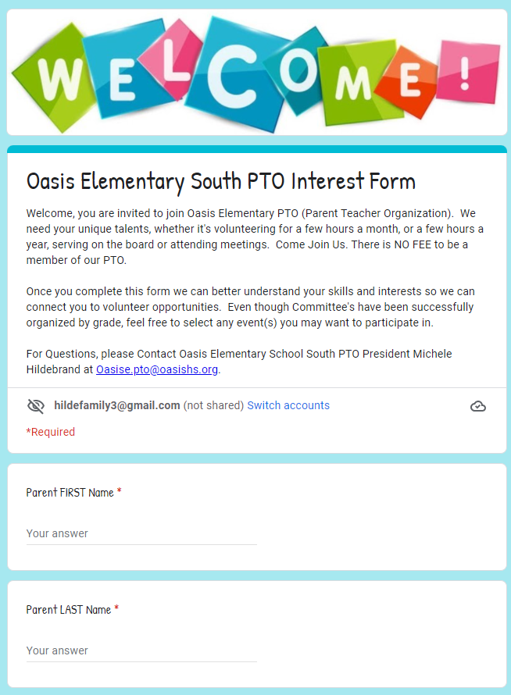
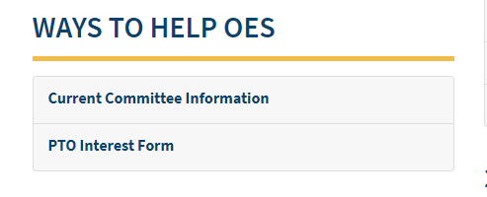
Committee Leads
On the PTO Rocks:

Slide 21
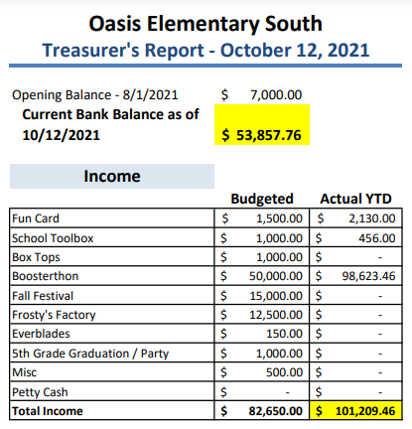
Treasurer’s Report
- October 12, 2021

Slide 22
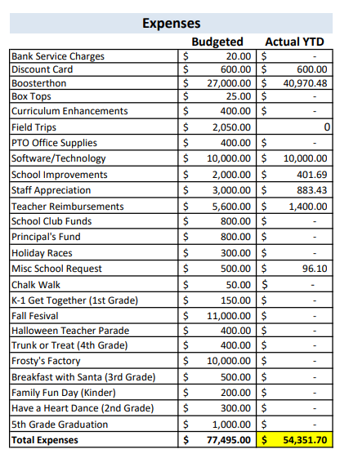
Treasurer’s Report
- October 12, 2021

Slide 23
Treasurer’s Report
- October 12, 2021
Budget Revision and Approval
Motion to move an extra $500 to Staff Appreciation
Motion to add a new category to budget for student fun day and add $2,000

Slide 24
Principal’s Report
Pending

Slide 25
Teacher Report
Tiffany Brown K-2
18th year teaching Kindergarten
Started at Oasis when it opened in 2005
Have 2 children at Oasis, 2nd and 4th grade
Kindergartners have done an AWESOME job adapting to Oasis
Starting Johnny Appleseed/ Fall with yummy treats
Cynthia Thompson 3-5
6th year teaching 5th Grade - First 5 years were in NY
First year teaching in Florida/at Oasis (Moved here from Western, NY in July)
Coaching Modified Girls Soccer at OMS/keeping book for OMS Mod. Basketball
Fifth Graders are very excited to be back in school and seeing friends
Students have enjoyed various science experiments and are excited for Booster-thon

Slide 26
Open Discussion

Slide 27
Next PTO Meeting: Tuesday, November 2nd, 2021
Thank You!

