Slide 1

Virtual PTO Meeting
Wednesday May 4, 2022
6:30pm
Join Via WebEx
Join WebEx meeting
Meeting number/Access Code: 2314 674 8164
Meeting password: Fcku2xd7im2
Join by phone
+1-415-655-0002 US Toll
+1-904-900-2303 United States Toll (Jacksonville)

Slide 2
Agenda
OES PTO MEETING 2021/2022
Welcome
Standing Agenda
Foundation: Samantha Richardson
President’s Report: Michele Hildebrand
Treasurer’s Report: Janet Blanco
Principal’s Report: Mrs. Grecsek
Teachers Report: Tiffany Brown
Elections
Open Discussion
Next PTO Meeting: Fall 2022
Adjournment

Slide 3
Standing Agenda
OES PTO MEETING 2021/2022
2021-2022 PTO Officers
  Michele Hildebrand – President
  Jeannette Blaustein –Vice –President
  Janet Blanco – Treasure
  Aimee Aubry -- Secretary
Communication
  Facebook- OES Families, please “Like” us
  Administration school Facebook page--Oasis Elementary South
  Parent Square and Panther Press
  PTO Rocks on the website

Slide 4
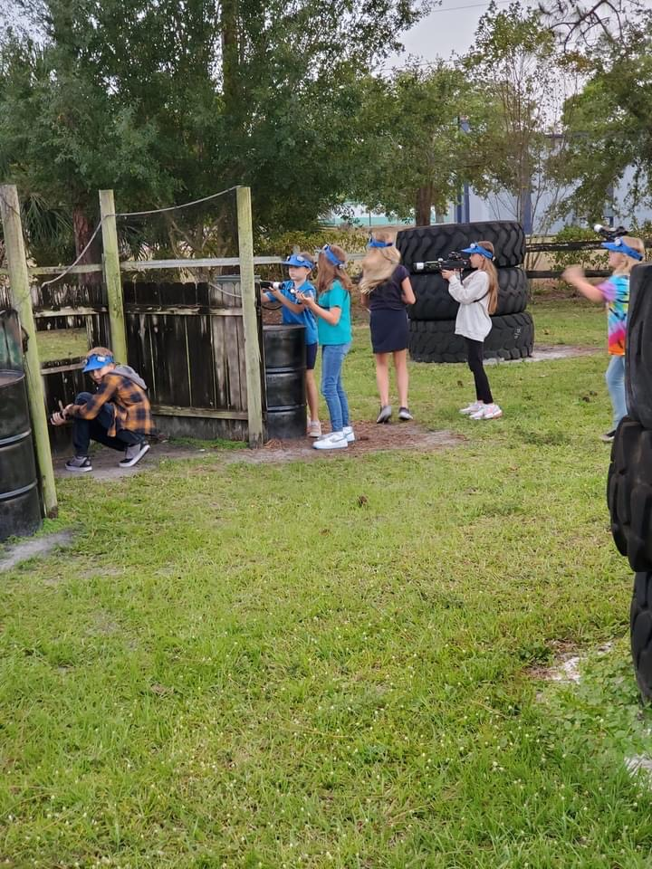
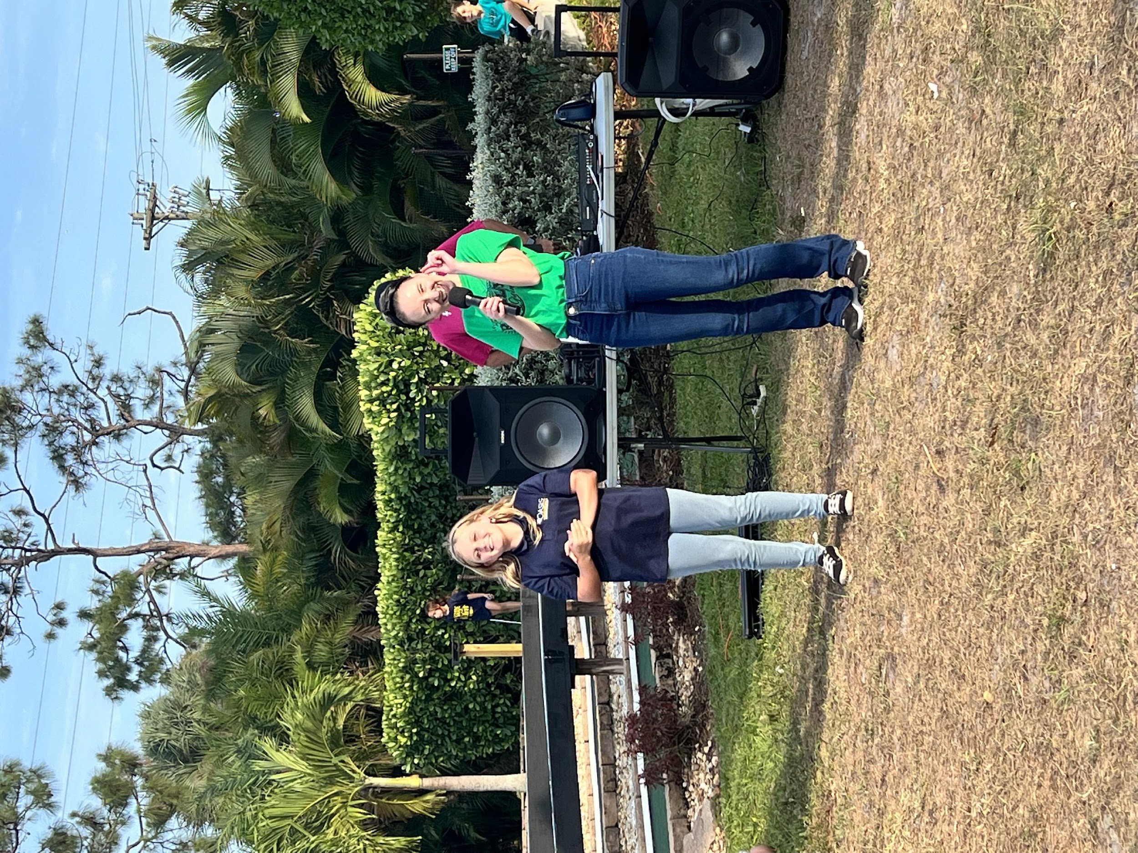
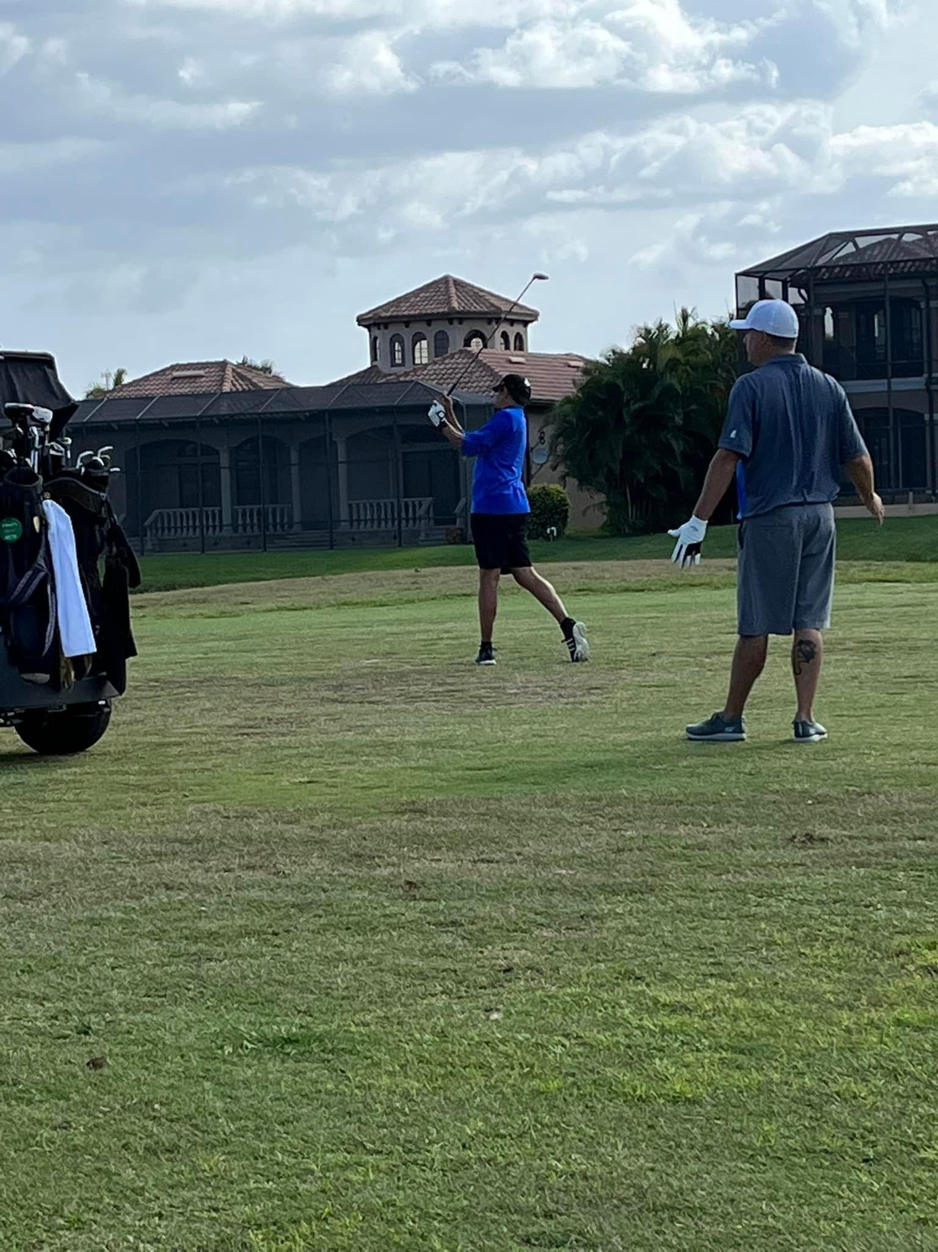
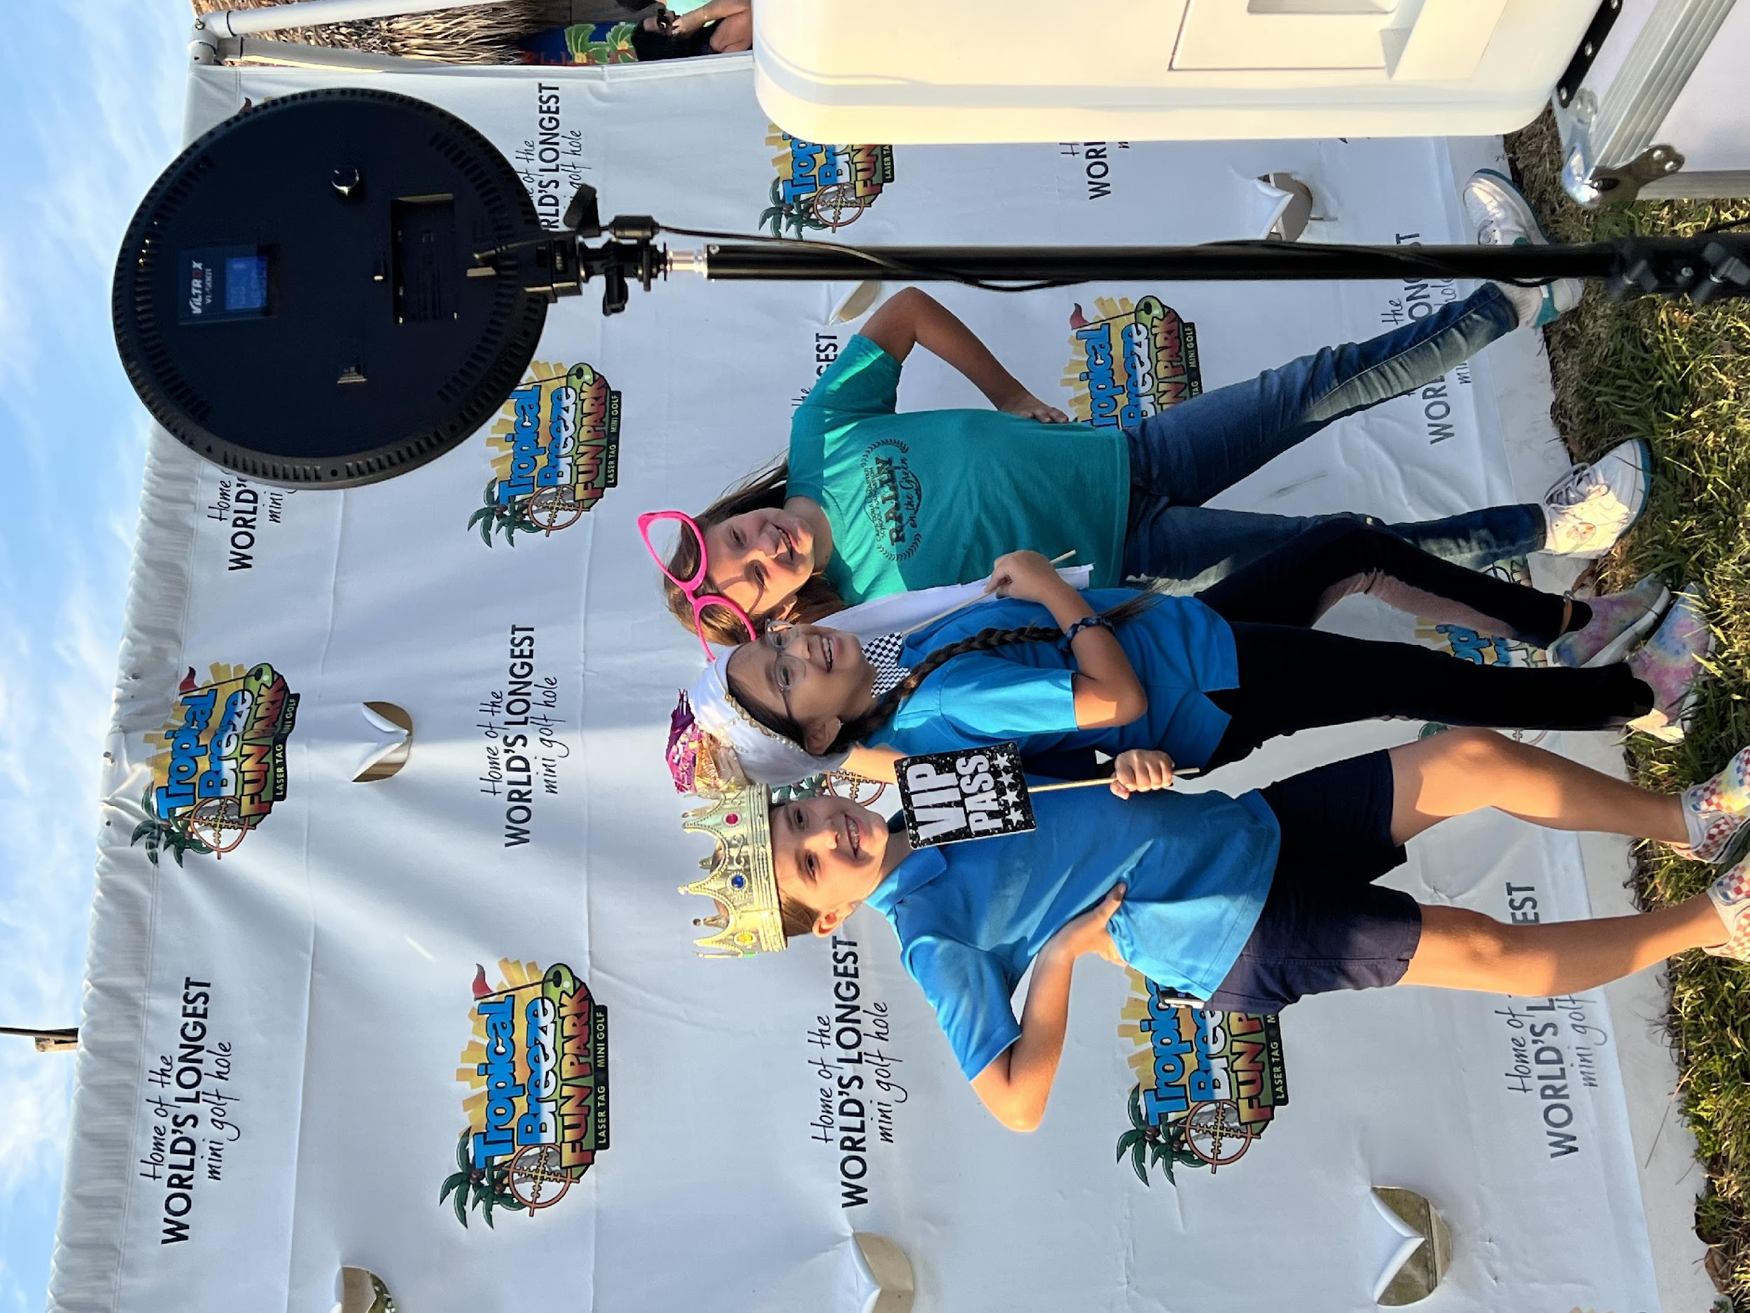
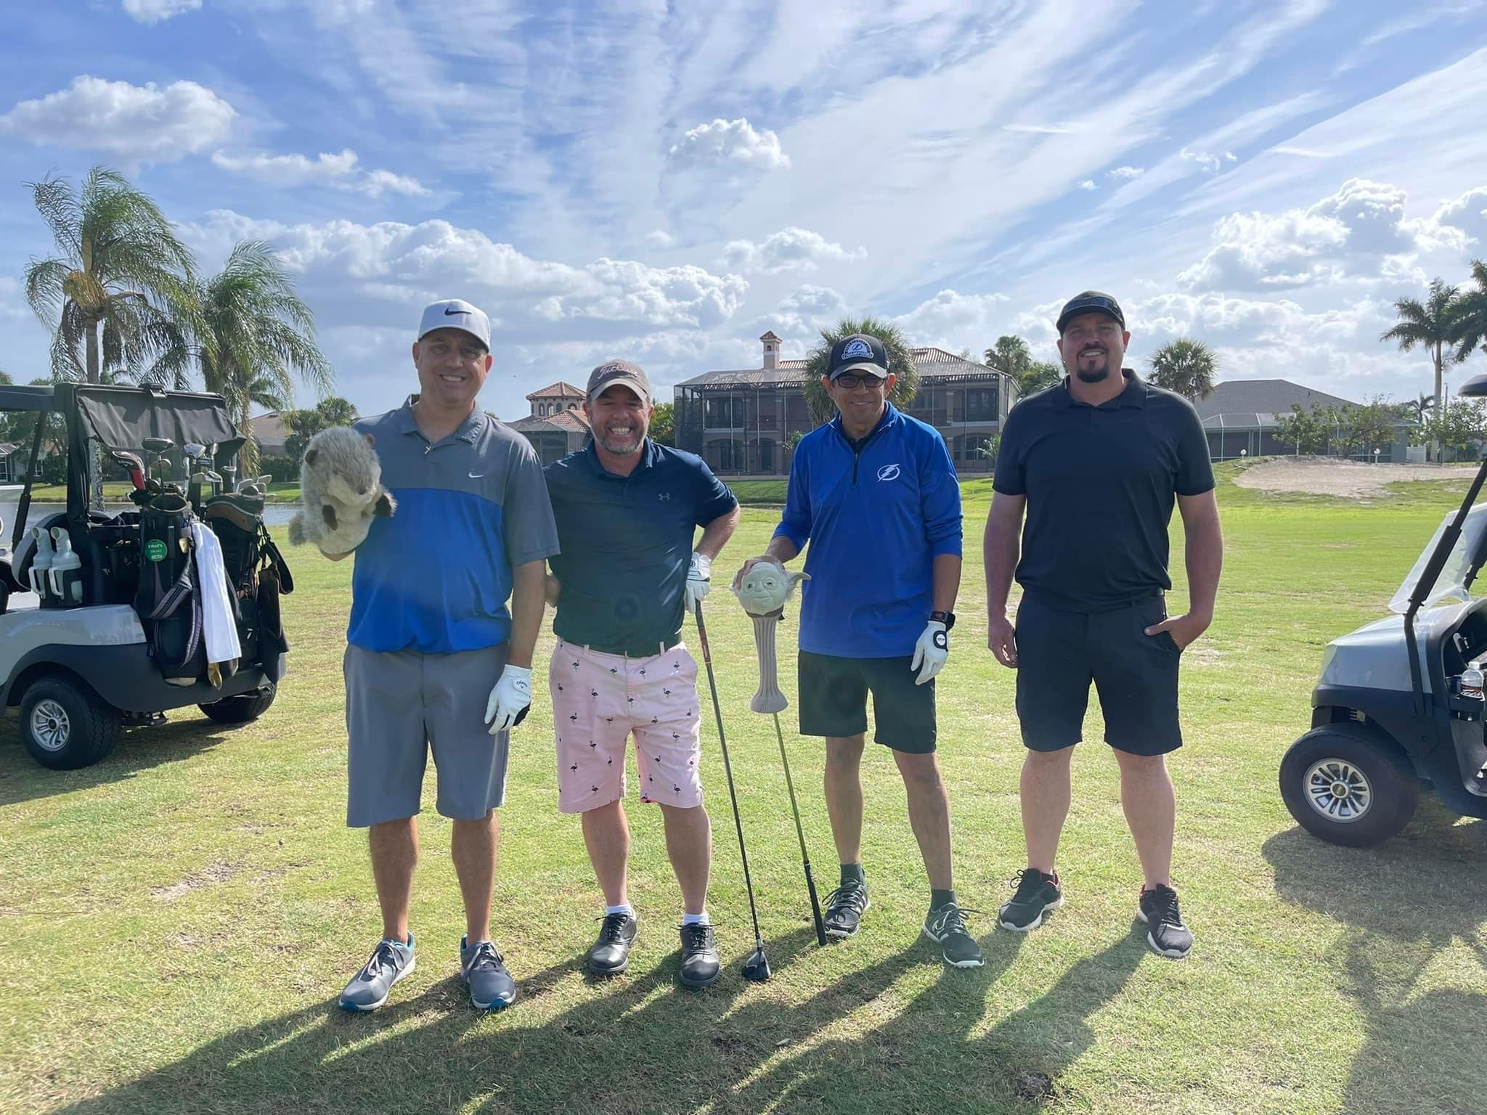
Foundation
Rally On The Green
Friday April 8th
  ^{Tropical Breeze fun Park}
Saturday April 9th
  Golfing at Cape Royal Golf Club
  ^{Auction}

Slide 5
President’s Report
Past Events
  Staff/Teacher Appreciation – Spring Easter Egg Hunt April 14
  Staff/Teacher Appreciation – Appreciation week April 25th – 29th
Upcoming Events
  Summer Bash Event
    May 23 &24 during school
New Business
  Elections
Old Business
  Box Tops

Slide 6
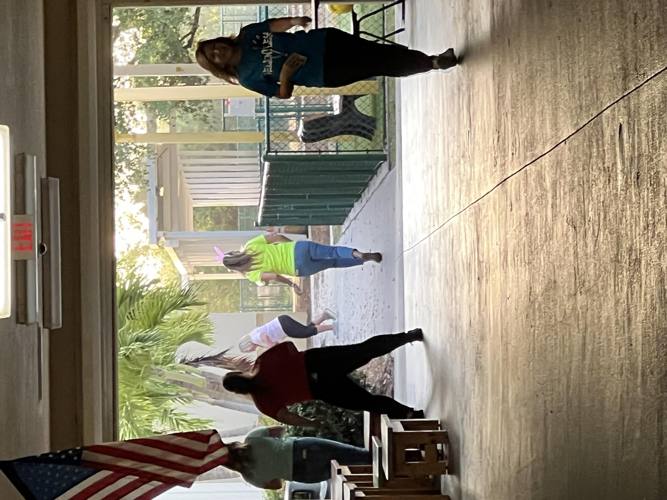
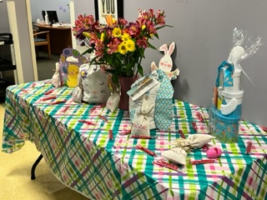
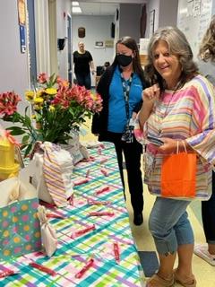
Past Events – Egg Hunt

Slide 7

Appreciation Week!
Huge Thank You
To all Our Parents who donated and baked all the yummy treats. Also for the donation of the beach bags! Without all of you, this week would not have been so successful.
A big shout our to the Appreciation Committee!!!

Slide 8
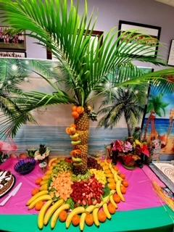
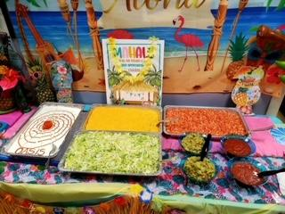
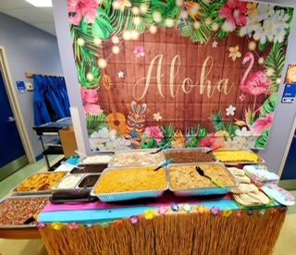
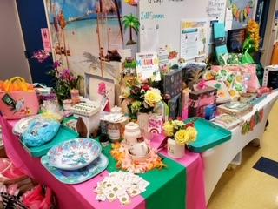
Past Events – Appreciation Week

Slide 9
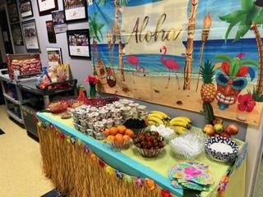
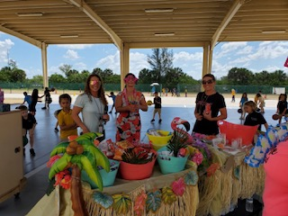
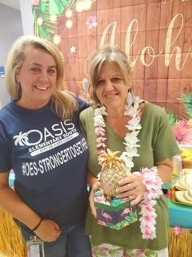
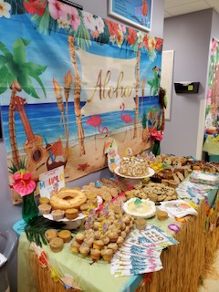
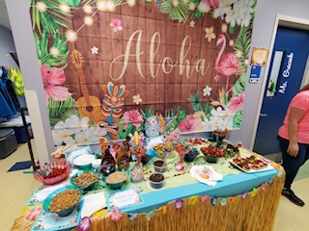

Slide 10

Past Events

Slide 11
PTO BOARD ELECTIONS - Interest
Board Nominations are still open for the co-president position.
If you are interested please email the PTO at oasise.pto@oasishs.org include a short bio and a few lines as to why you want to be on the board.

Slide 12
ELECTIONS – Duties of Elected Officers
PRESIDENT:
▪ Shall preside over all PTO Board, General, and Special Meetings.
▪ Know and follow the By-Laws of the organization.
▪ Coordinate the work of the Officers and Committees, in order that the objectives of the PTO may be promoted.
▪ Assist in the preparation of an annual budget.
▪ Prepare in advance of each meeting a complete agenda showing the order in which business will be addressed at the meeting.
▪ Ensure accurate and consistent communication between the Board members.
▪ Shall oversee the PTO webmaster and website to ensure it contains updated an accurate information.
▪ Attend City of Cape Coral Charter School Governing Authority meetings when possible.
▪ Shall serve as the liaison between the PTO and the City of Cape Coral Charter School Governing Authority.

Slide 13
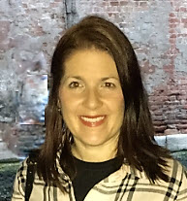

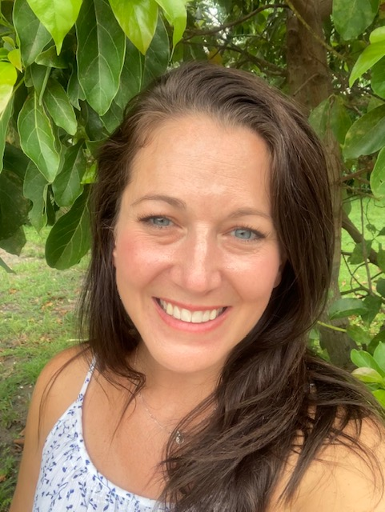
Candidates for PTO BOARD 2022-2023
Yes we are all volunteers!
Michele Hildebrand
Co - President
Vacant
Co - President
Jeanette Blaustein
Vice President
Janet Blanco
Treasurer
Aimee Aubrey
Secretary
Active Oasis Family Member Since 2016
Active Oasis Family Member Since 2016
Active Oasis Family Member Since 2006
Active Oasis Family Member Since 2015
Contact us at: oasise.pto@oasishs.org

Slide 14
Old Business

Slide 15

Box Tops
Popular participating products:

Slide 16
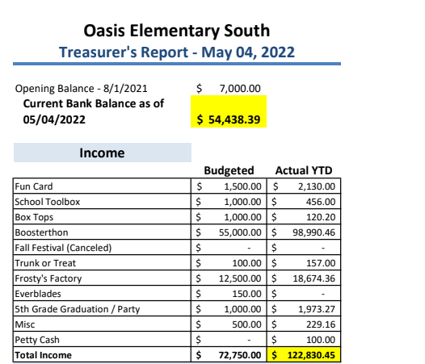
Treasurer’s Report
- May, 2022
Income

Slide 17
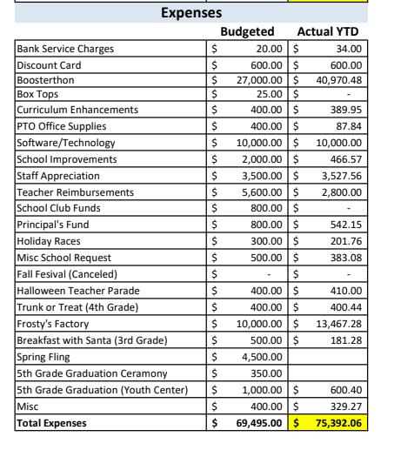
Treasurer’s Report
- May 2022
Expenses

Slide 18
Principal’s Report

Slide 19
Teacher Report

Slide 20
Open Discussion

Slide 21
Next PTO Meeting: May 4, 2022
Thank You!

Slide 22
Agenda
OES PTO MEETING 2021
Welcome
Standing Agenda
Guest Speaker: Mr. Hopper
Foundation:
President’s Report: Michele Hildebrand
Treasurer’s Report: Janet Blanco
Principal’s Report: Mrs. Grecsek
Teachers Report: Tiffany Brown & Cynthia Thompson
Open Discussion
Next PTO Meeting: February 9th
Adjournment

Slide 23
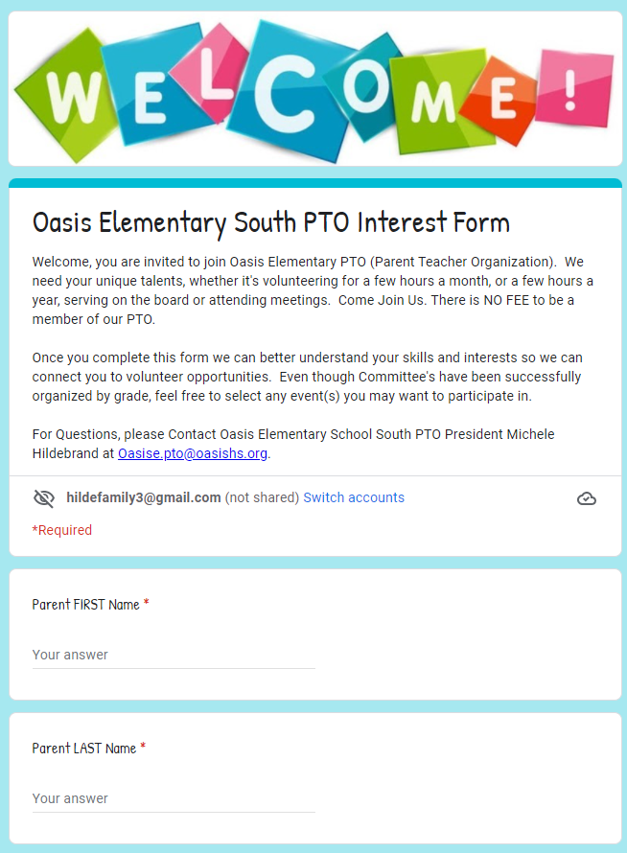
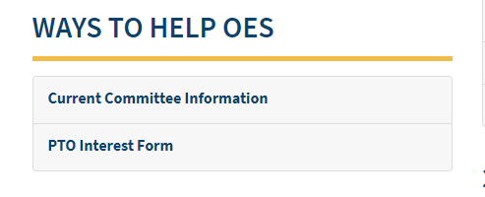
Committee Leads
On the PTO Rocks:

Slide 24
Committee Leads
We plan to continue to have our "Family Fun" Events organized by different grade levels. Please consider getting involved!
Kindergarten Committee FAMILY FUN EVENT
Timeframe: Spring
Members: Yosniel Vento, Lianet Morejon, Ganna Gaber, Erin Wilson, Stephanie Rochelle, Jami Kolev, Christine Baron
1st Grade Committee FAMILY DANCE
Timeframe: February/March
Members: Autumn Clark, Karoline Fabril, Amanda Rourke, Jelena Cianchetta
2nd Grade Committee Event is BOO HOO BREAKFAST & KINDER WELCOME COMMITTEE
Timeframe: Summer & August
Members: Amanda Rourke, Christine Baron
3rd Grade Committee Event is HOLIDAY EVENT
Timeframe: December
Members: Phoenix Proffitt, Ganna Gaber, Amanda Rourke, Stephanie Rochelle, Christine Baron
4th Grade Committee Event is TRUNK OR TREAT
Timeframe: October
Members: Mara Brown & Lindsey Zimmerman
5th Grade Committee Event is the MOVING UP PARTY
Timeframe: May/June
Members: Heather Dinkle, Sam Richardson, Janielle Marrero

Slide 25
Past Events

Slide 26
Music
Guest Speaker:
Christina Placke

