Slide 1

Virtual PTO Meeting
Tuesday, February 15
6:30pm
Join Via WebEx
Join WebEx meeting
Meeting number/Access Code: 2309 861 8340
Meeting password: BBmFex7ik23
Join by phone
+1-415-655-0002 US Toll
+1-904-900-2303 United States Toll (Jacksonville)

Slide 2
Agenda
OES PTO MEETING 2021/2022
Welcome
Standing Agenda
Foundation: Samantha Richardson
President’s Report: Michele Hildebrand
Treasurer’s Report:
Principal’s Report: Mrs. Grecsek
Teachers Report: Tiffany Brown
Open Discussion
Next PTO Meeting: March 4
Adjournment

Slide 3
Standing Agenda
OES PTO MEETING 2021/2022
2021-2022 PTO Officers
  Michele Hildebrand – President
  Jeannette Blaustein –Vice –President
  Janet Blanco – Treasure
  Aimee Aubry -- Secretary
Communication
  Facebook- OES Families, please “Like” us
  Administration school Facebook page--Oasis Elementary South
  Parent Square and Panther Press
  PTO Rocks on the website

Slide 4
Foundation
Lighthouse Award’s
Observation our going on now
Rally On The Green
Saturday April 9th
Golfing at Cape Royal Golf Club
More information to come!
WINNERS WILL BE ANNOUNCED AT THE LIGHTHOUSE AWARDS DINNER ON SUNDAY, MARCH 6, 2022

Slide 5
President’s Report
Past Events
  Donuts with Santa
  Frosty Factory
Upcoming Events
  Staff/Teacher Appreciation – Valentine’s Breakfast
New Business
  Spring Events
Old Business
  Box Tops

Slide 6
Past Events

Slide 7
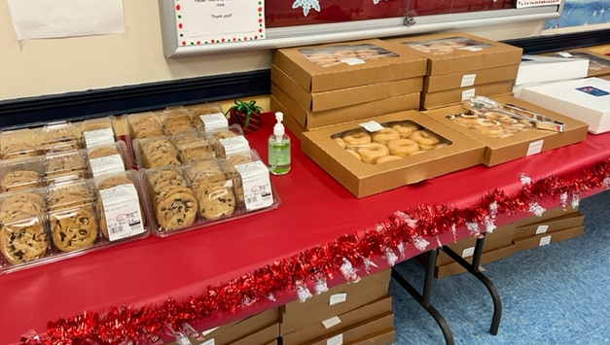
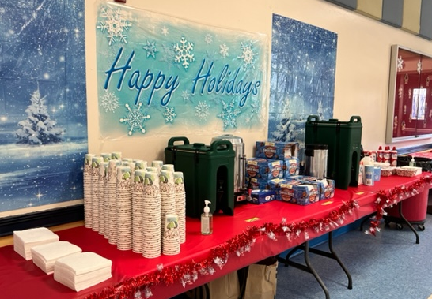
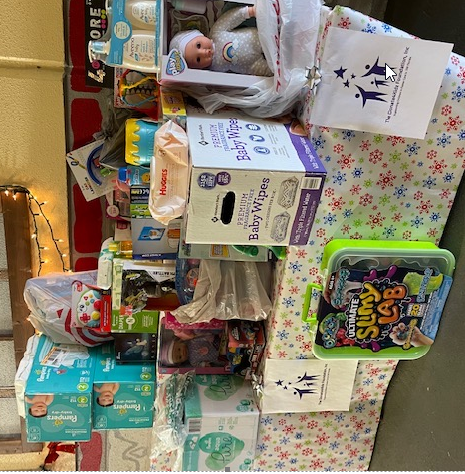
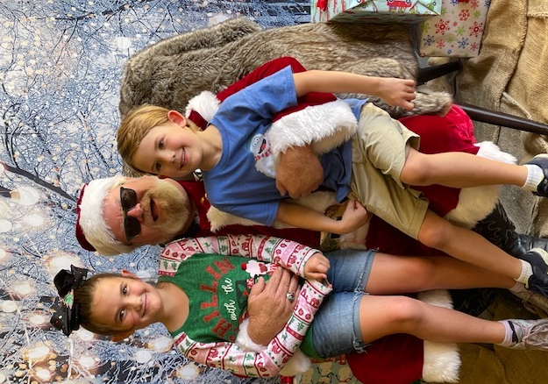
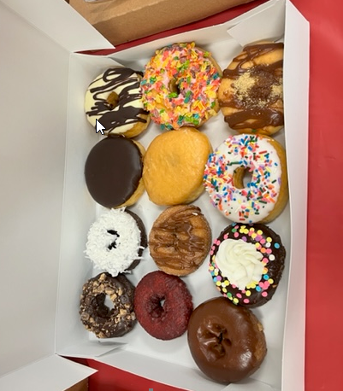
Donuts with Santa
Huge Thank You:
Stephanie Rochelle
Amanda Rourke
Whitney Ellis
Santa (Jessica Marshall father-n-law)
All the parent volunteers
Costco and Divine Donuts
Pictures on OES Families on Facebook!

Slide 8
Old Business

Slide 9
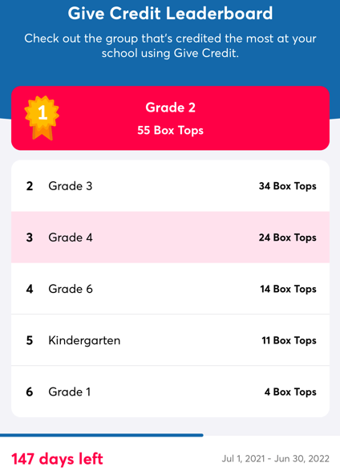
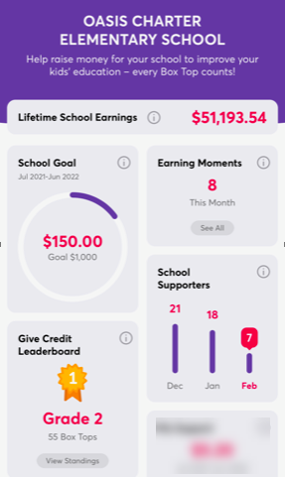
Box Tops

Slide 10

Box Tops
Popular participating products:

Slide 11


Slide 12
Treasurer’s Report
- November 02, 2021
Income

Slide 13
Treasurer’s Report
- November 2, 2021
Expenses

Slide 14
Principal’s Report
Mrs. Grescek
Introduction of two new teachers
K-2 clubs info going out this week

Slide 15
Teacher Report
Tiffany Brown K-5
Update

Slide 16
Open Discussion

Slide 17
Next PTO Meeting: March 2, 2022
Thank You!

Slide 18
Fall Festival
Could become a Spring Festival

Slide 19
Agenda
OES PTO MEETING 2021
Welcome
Standing Agenda
Guest Speaker: Mr. Hopper
Foundation:
President’s Report: Michele Hildebrand
Treasurer’s Report: Janet Blanco
Principal’s Report: Mrs. Grecsek
Teachers Report: Tiffany Brown & Cynthia Thompson
Open Discussion
Next PTO Meeting: February 9th
Adjournment

Slide 20
Music
Guest Speaker:
Christina Placke

Slide 21
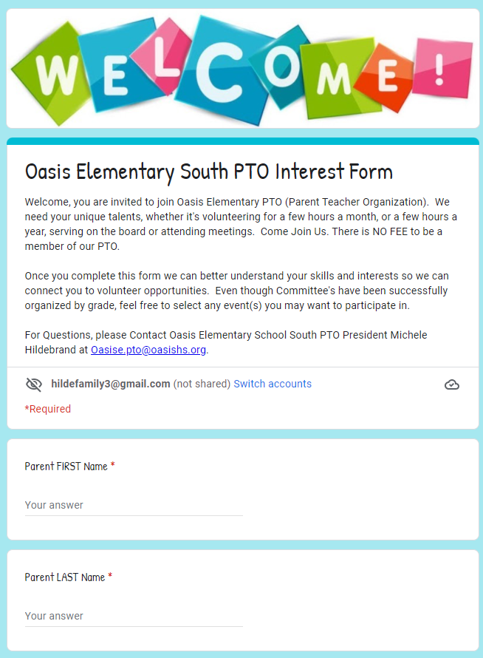
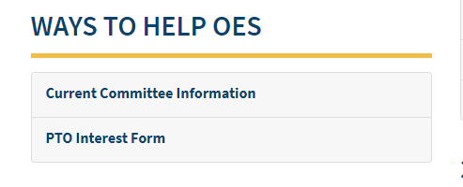
Committee Leads
On the PTO Rocks:

Slide 22
Committee Leads
We plan to continue to have our "Family Fun" Events organized by different grade levels. Please consider getting involved!
Kindergarten Committee FAMILY FUN EVENT
Timeframe: Spring
Members: Yosniel Vento, Lianet Morejon, Ganna Gaber, Erin Wilson, Stephanie Rochelle, Jami Kolev, Christine Baron
1st Grade Committee FAMILY DANCE
Timeframe: February/March
Members: Autumn Clark, Karoline Fabril, Amanda Rourke, Jelena Cianchetta
2nd Grade Committee Event is BOO HOO BREAKFAST & KINDER WELCOME COMMITTEE
Timeframe: Summer & August
Members: Amanda Rourke, Christine Baron
3rd Grade Committee Event is HOLIDAY EVENT
Timeframe: December
Members: Phoenix Proffitt, Ganna Gaber, Amanda Rourke, Stephanie Rochelle, Christine Baron
4th Grade Committee Event is TRUNK OR TREAT
Timeframe: October
Members: Mara Brown & Lindsey Zimmerman
5th Grade Committee Event is the MOVING UP PARTY
Timeframe: May/June
Members: Heather Dinkle, Sam Richardson, Janielle Marrero

